Slide 1
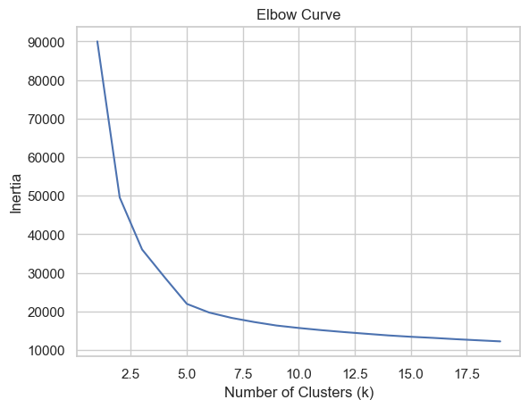
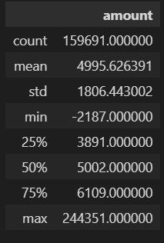
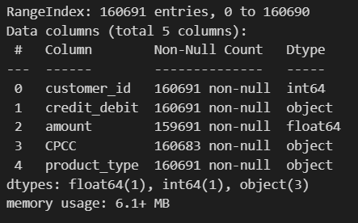
Notes:
A good model is one with low inertia anda low number of clusters. The rate of the inertia reduction significantly changes at 5 clusters. I will use 5 clusters in my model.

Slide 2
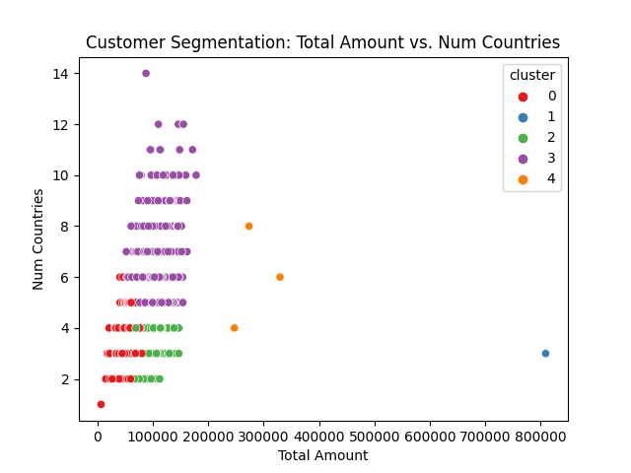
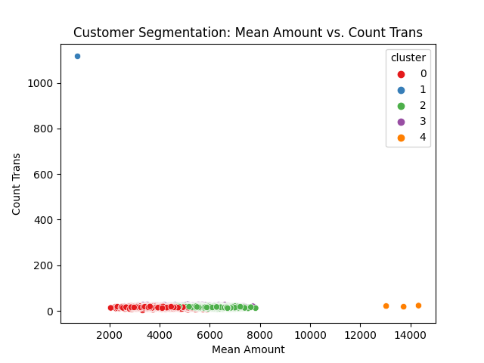
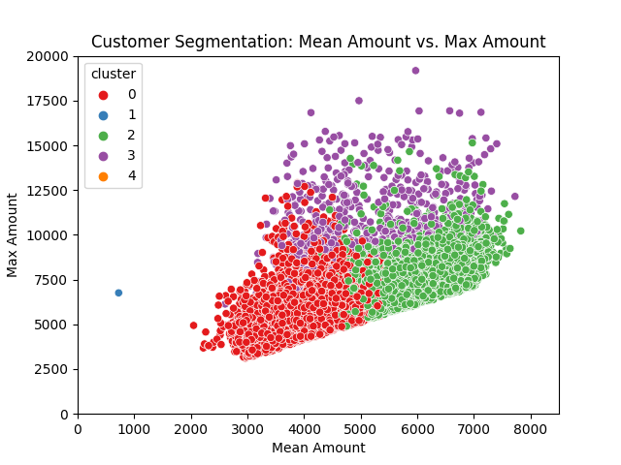
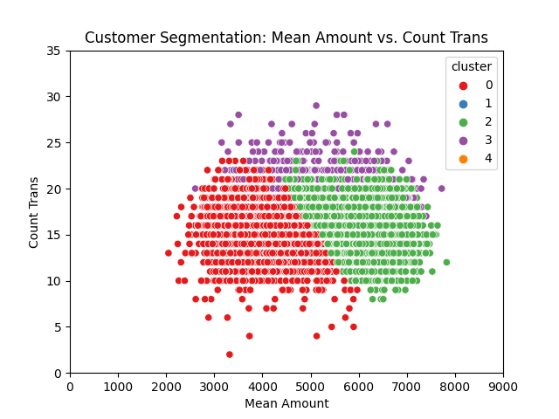
Customer segmentation
Notes:
Money laundering, terrorism financing, and tax evasion usually involve large sums of money. However, these large transactions are easier to detect, so criminals often use a technique known as structuring or smurfing to break them up into smaller transactions and move them through multiple accounts to avoid detection and create a legitimate appearance for the funds.To identify customers with a high risk of engaging in AML/CTF/ATE activities, we are searching for indicators such as large transactions, a high volume of transactions, and transactions involving a significant number of countries. These characteristics may suggest that the customer is attempting to conceal their activities or evade detection. To identify suspicious customers engaging in such activities, I have aggregated data based on customers and analyzed several key fields.
Total Amount: The total amount of money by each customer is a crucial field in determining their transactional behavior, as customers who transfer large amounts of money may be engaged in suspicious activities.
Average Amount): The average transaction amount made by each customer is another important field in identifying their transactional behavior. Customers with significantly higher or lower average transaction amounts compared to their peers may be engaging in suspicious activities.
Max Amount: Flagging transactions involving large amounts is important because while some customers may not be attempting to avoid detection or structure their transactions, large transactions can still be indicative of an attempt of moving large sums of money and the use of multiple accounts to hide the source and destination of the funds.
Moreover, even if a customer is not engaging in illegal activities, large transactions can still pose a risk to the bank or financial institution processing the transaction. For instance, large transactions may indicate that a customer is engaging in high-risk investments or may be experiencing financial distress. This information can be valuable for banks and financial institutions in determining whether to approve or decline a transaction, and to assess the level of risk associated with a particular customer or transaction.
Transaction Count: The number of transactions made by each customer is also essential in identifying their transactional behavior. Customers who make an excessive number of transactions within a short period of time may be attempting to avoid detection or engage in suspicious activities.
Number of countries: Furthermore, the number of countries involved in a customer's transactions can also be an important factor in identifying suspicious behavior. Customers who frequently transact with individuals or entities in multiple countries may be attempting to hide their activities or evade detection. However, this information alone may not be sufficient to flag a customer as suspicious, as some legitimate businesses may transact with multiple countries.
From an anti-money laundering/tax evasion/counter-terrorism financing perspective, clusters 1, 3, and 4 would require closer scrutiny.
Cluster 1: Only 1 customer which stands out due to its abnormally low average transaction amount and high number of transactions in plot 2, which could suggest suspicious structuring or smurfing activity.
Cluster 4: 3 customers with all has a high total amount, which could indicate suspicious activity. However, further analysis would be required to determine if this is due to legitimate business activity or if there are other factors at play. There’s three other clusters and this is how they compare to the average customer:
Cluster 3: Highest risk. 1182 customers with higher average and higher max transaction. Higher number of transactions and higher number of countries.
Cluster 2: Average risk. 4264 customers with higher average and higher max transaction. Fewer number of transactions and lower number of countries.
Cluster 0: Lowest risk. 4550 customers with lower average and lower max transaction. Average number of transactions and lower number of countries.
Cluster 3 has a high maximum amount and a large number of transactions, which may indicate attempts to move large sums of money and could be a potential indicator of illicit activity. Additionally, Cluster 3 has the highest number of countries involved in their transactions, which may also be a red flag.

Slide 3
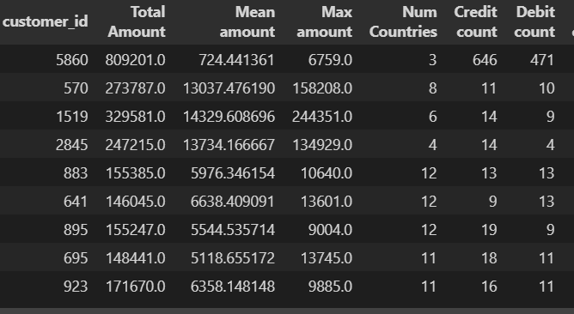
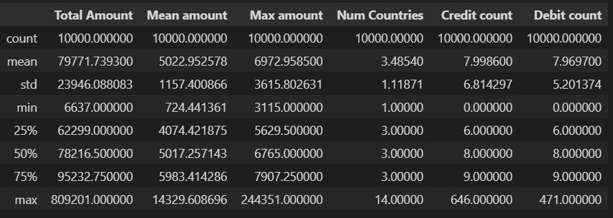
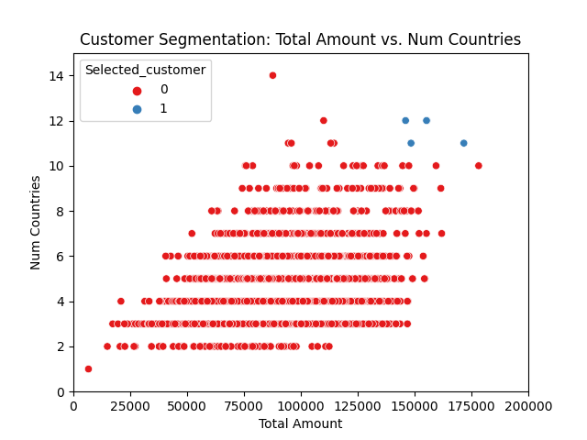
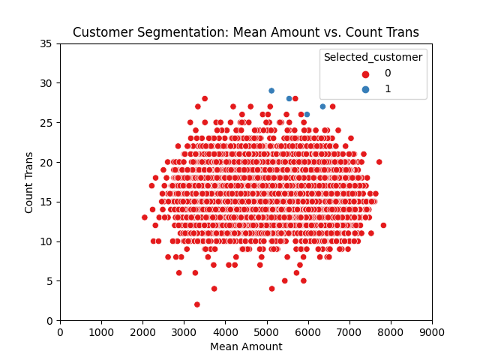
Selected customers
Notes:
Cluster 1/customer 5860 stands out from the rest of the dataset and is in its own cluster. This customer has made 1117 transactions, which is significantly higher than the average of 16 transactions in the dataset, and the transactions are in relatively small amounts. However, this customer has only made transactions to Sweden, Finland, and Denmark, which are not considered high-risk countries. Nevertheless, this behavior can be a sign of structuring.
Cluster 4/customers 570, 1519, 2845: These customers all have one transaction that stands out from their usual transactions. 570: Only one transaction (158208) to Romania (no transactions from) and 14 times as big as the next biggest transaction. In addition, this customer has had a lot of transactions (21) and is transacting with a lot of countries in general (8 countries). 1519: only debit transaction to DK and 37 times as big as this customers next biggest transaction. High number of transactions (23) and is transacting with a lot of countries in general (6 countries). 2845: Only one transaction (134929) from Romania (no transactions from) and 18 times as big as the next biggest transaction. In addition, this is the only transaction outside of Finland, Denmark and Sweden.
Cluster 3/customers 883, 641, 895, 695, and 923: 150 customers in this cluster have sent or received money from more than 7 countries (2 times more countries than the average customer). Customers 883, 641, 895, 695, and 923 have transacted with more than 10 countries (3 times more than the average customer), have made more transactions than the average customer, and have transacted almost double the amount of the average customer.

Slide 4
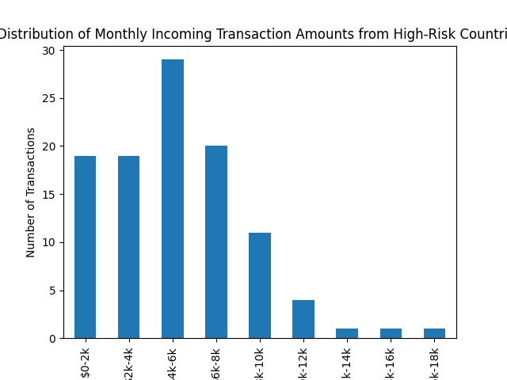
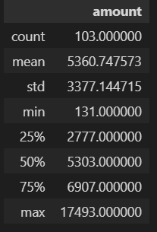
High risk countries
Conclusion
Threshold: 6,907 75 % percentile
26 customers to investigate
4 customers, that clearly sticks out from the rest
Cluster 0 with lowest-risk customer, cluster 2 with average risk and cluster 0 with highest-risk customers
Notes:
26 customers breaks the threshold of maximum 6907 to a high-risk country: 615, 675, 779, 803, 806, 853, 961, 3056, 3113, 3344, 3421, 3435, 3452, 4035, 4109, 4205, 4214, 4433, 7034, 7104, 7111, 7121, 7231, 7235, 7238, 7493
The high-risk country rule is a criterion used in anti-money laundering (AML) and counter-terrorism financing (CTF) to identify and assess higher risks of money laundering and terrorism financing activities coming from certain countries. I have used the countries stated on the European Commisions website. Countries that have been identified as high-risk are those that have weaker AML/CTF frameworks or that have been associated with a higher incidence of financial crime or terrorist financing.
I have used the 75 % percentile as the threshold to identify the customers. This is because the transactions are already filtered for high-risk country, so to choose a lower threshold reduces the risk of missing critical transactions.

